Slide 1


February 2019
Deep Learning For Case-Based Reasoning through Prototypes: A Neural Network that Explains Its Own Predictions
O. Li, H. Liu, C. Chen and C. Rudin, 2018 AAAI Conference
Review presented by
Mai Lee Chang, Marius Arvinte
The University of Texas at Austin

Slide 2
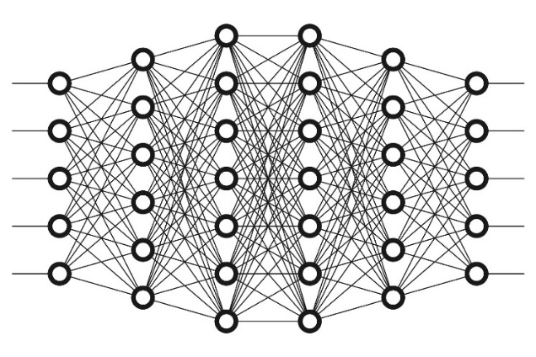
Motivation
Advantages of Deep Neural Networks:
Very high modeling power
Training is now ubiquitous, fast and cheap
Inference is even faster and cheaper!
Despite this, DNNs are still considered black boxes → very low interpretability
Very recent work in theoretically explaining how two-layer DNNs with ReLU activations work…
… using (literally) 100 pages of theorems!
[Mei, Montanari, Nguyen, ‘18] A Mean Field View of the Landscape of Two-Layers Neural Networks
Societal impacts:
Unfairly long prison sentences
Challenges with government approval of deep learning products
This work aims to train an interpretable deep learning model for classification in a practical manner.

Slide 3
Prior work
Posthoc interpretability analysis
First train, then explain
Activation maximization [Erhan, ‘09]
Find inputs that maximize outputs at different layers.
Requires a lot of effort.
Visualize weights of CNN layers [Zeiler, Fergus, ‘14]
Issues:
There may be multiple explanations for how the network would make the classification but none of them was actually the correct reason.
Explanations that are not understandable to human → need extra modeling
Built-in interpretability → This work
Prior work focuses on identifying relevant parts of inputs (images).
This work uses case-based reasoning → Explain based on global similarity to prototypes.
Prototype = Very close or identical to an observation in the training set.
Prototypes used before, but in the image space.

Slide 4



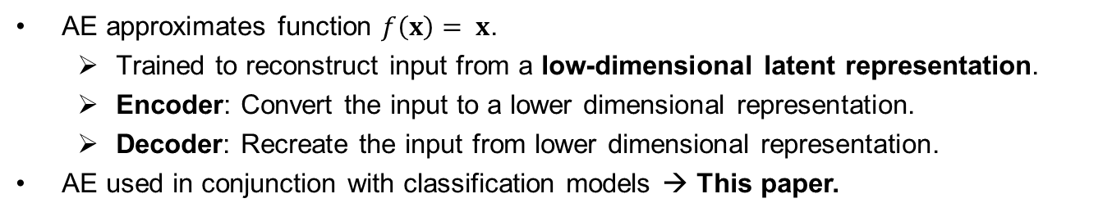

Autoencoders (AE) for classification
AE approximates function $f\left(x\right)= x$.
Trained to reconstruct input from a low-dimensional latent representation.
Encoder: Convert the input to a lower dimensional representation.
Decoder: Recreate the input from lower dimensional representation.
AE used in conjunction with classification models → This paper.
Latent space representation
Encoder
Classifier
$$\tilde{y}$$
Original input
Decoder
Reconstructed input

Slide 5
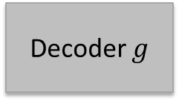

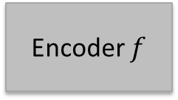




Network architecture
Prototype classifier network $h$
Fully Connected
Layer
W
Soft-max Layer
s
Prototype Layer
p
$$\tilde{y}=h\left(f\left(x\right)\right)$$
$$x$$
Encoder $f$
$$z=f(x)$$
$$\tilde{x}=g\left(f\left(x\right)\right)$$
Decoder $g$

Slide 6
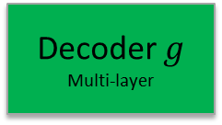
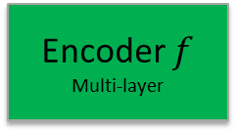
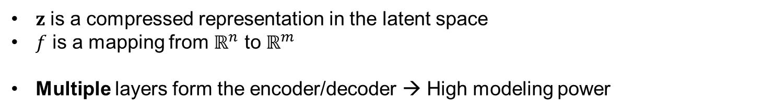
Network architecture
Prototype classifier network $h$
Fully Connected
Layer
W
Soft-max Layer
s
Prototype Layer
p
$$\tilde{y}=h\left(f\left(x\right)\right)$$
$$x$$
Encoder $f$
Multi-layer
$$z=f(x)$$
$$\tilde{x}=g\left(f\left(x\right)\right)$$
Decoder $g$
Multi-layer
$z$ is a compressed representation in the latent space
$f$ is a mapping from $ℝ^{n}$ to $ℝ^{m}$
Multiple layers form the encoder/decoder → High modeling power
Notes:
During training, the decoder reconstructs the original image. Later, it’s used for interpretability.

Slide 7


Network architecture
Prototype classifier network $h$
Fully Connected
Layer
W
Soft-max Layer
s
Prototype Layer
p
$$\tilde{y}=h\left(f\left(x\right)\right)$$
$$x$$
Encoder $f$
$$z=f(x)$$
$$v(z)$$
$$\tilde{x}=g\left(f\left(x\right)\right)$$
Decoder $g$
$$v\left(z\right)={\left({\left\|z−p_{1}\right\|}_{2}^{2},{\left\|z−p_{2}\right\|}_{2}^{2}, …{\left\|z−p_{m}\right\|}_{2}^{2}\right)}^{T}∈ℝ^{m}$$
This is the main contribution of the paper:
Layer outputs distances from inputs to its trainable weights → use for classification
Similar behavior to clustering and SOM
Note: Paper uses p for output notation, is confusing.

Slide 8

Network architecture
Prototype classifier network $h$
Fully Connected
Layer
W
Soft-max Layer
s
Prototype Layer
p
$$\tilde{y}=h\left(f\left(x\right)\right)$$
$$x$$
Encoder $f$
$$z=f(x)$$
$$\tilde{x}=g\left(f\left(x\right)\right)$$
Decoder $g$
$W∈ℝ^{m×K}$
Linear activation → linear combinations of distances

Slide 9
Network architecture
Prototype classifier network $h$
Fully Connected
Layer
W
Soft-max Layer
s
Prototype Layer
p
$$\tilde{y}=h\left(f\left(x\right)\right)$$
$$x$$
Encoder $f$
$$z=f(x)$$
$$\tilde{x}=g\left(f\left(x\right)\right)$$
Decoder $g$
Output represents probability of belonging to each class.

Slide 10


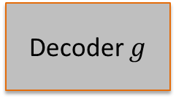



Interpretability of p
Fully Connected
Layer
W
Soft-max Layer
s
Prototype Layer
p
$$\tilde{y}=h\left(f\left(x\right)\right)$$
$$x$$
Encoder $f$
$$z=f(x)$$
$$x_{p}=g(p)$$
Decoder $g$
Once training is completed, run the prototype vectors through decoder to obtain their natural image representation.
This is not in the original training set, but is a learned prototype image used for classification in the latent space.

Slide 11

Loss function design
$$L\left(x;W, p, θ\right)=\frac{1}{n}\sum_{i=1}^{n}{{\left\|x_{i}−g\left(f\left(x_{i}\right)\right)\right\|}^{2}}+\frac{1}{n}\sum_{i=1}^{n}{\sum_{k=1}^{K}{1\left(y_{i}=k\right)log⁡(h{\left(f\left(x_{i}\right)\right)}_{k}}}+\frac{1}{m}\sum_{j=1}^{m}{\min_{i∈[1, n]}{{\left\|p_{j}−f\left(x_{i}\right)\right\|}^{2}}}+\frac{1}{n}\sum_{i=1}^{n}{\min_{j∈[1,m]}{{\left\|f\left(x_{i}\right)−p_{j}\right\|}^{2}}}$$
Autoencoder loss function.
L₂ reconstruction error.
Ensures latent representation contains relevant information on x.

Slide 12
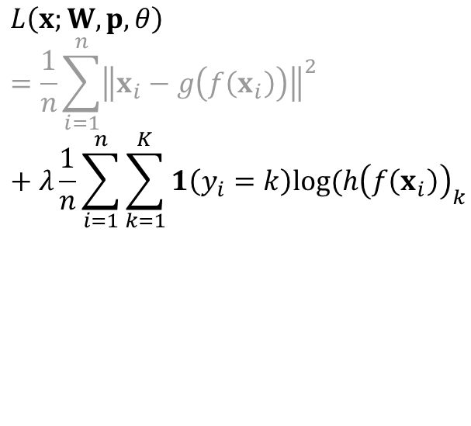
Loss function design
$$L\left(x;W, p, θ\right)=\frac{1}{n}\sum_{i=1}^{n}{{\left\|x_{i}−g\left(f\left(x_{i}\right)\right)\right\|}^{2}}+λ\frac{1}{n}\sum_{i=1}^{n}{\sum_{k=1}^{K}{1\left(y_{i}=k\right)log⁡(h{\left(f\left(x_{i}\right)\right)}_{k}}}+\frac{1}{m}\sum_{j=1}^{m}{\min_{i∈[1, n]}{{\left\|p_{j}−f\left(x_{i}\right)\right\|}^{2}}}+\frac{1}{n}\sum_{i=1}^{n}{\min_{j∈[1,m]}{{\left\|f\left(x_{i}\right)−p_{j}\right\|}^{2}}}$$
Autoencoder loss function.
L₂ reconstruction error.
Ensures latent representation contains relevant information on x.
Cross-entropy loss function.
Cross-entropy.
Ensures latent representation contains relevant information for classification.

Slide 13
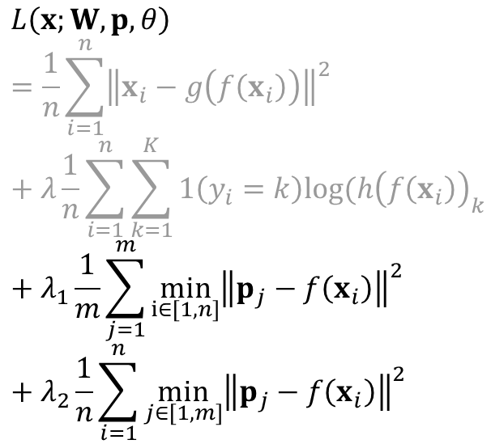
Loss function design
$$L\left(x;W, p, θ\right)=\frac{1}{n}\sum_{i=1}^{n}{{\left\|x_{i}−g\left(f\left(x_{i}\right)\right)\right\|}^{2}}+λ\frac{1}{n}\sum_{i=1}^{n}{\sum_{k=1}^{K}{1\left(y_{i}=k\right)log⁡(h{\left(f\left(x_{i}\right)\right)}_{k}}}+λ_{1}\frac{1}{m}\sum_{j=1}^{m}{\min_{i∈[1, n]}{{\left\|p_{j}−f\left(x_{i}\right)\right\|}^{2}}}+λ_{2}\frac{1}{n}\sum_{i=1}^{n}{\min_{j∈[1,m]}{{\left\|p_{j}−f\left(x_{i}\right)\right\|}^{2}}}$$
Autoencoder loss function.
L₂ reconstruction error.
Ensures latent representation contains relevant information on x.
Cross-entropy loss function.
Cross-entropy.
Ensures latent representation contains relevant information for classification.
R₁ term → Ensures p are interpretable.
R₂ term → Ensures p are good for classification.

Slide 14
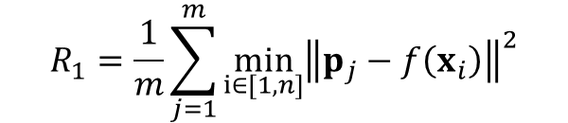
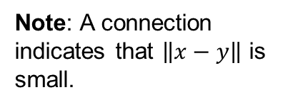


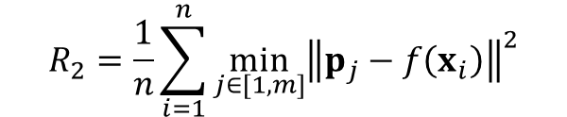
Regularization terms explained
$$R_{1}=\frac{1}{m}\sum_{j=1}^{m}{\min_{i∈[1, n]}{{\left\|p_{j}−f\left(x_{i}\right)\right\|}^{2}}}$$
$$R_{2}=\frac{1}{n}\sum_{i=1}^{n}{\min_{j∈[1,m]}{{\left\|p_{j}−f\left(x_{i}\right)\right\|}^{2}}}$$
Every prototype vector p has at least one data point close to it in the latent space.
Not sufficient for good classification!
Every data point has at least one prototype vector p close to it in the latent space.
Ensures prototypes are meaningful for classification via clustering.
Note: A connection indicates that $\left\|x−y\right\|$ is small.
$$z=f\left(x\right)$$
$$p$$

Slide 15
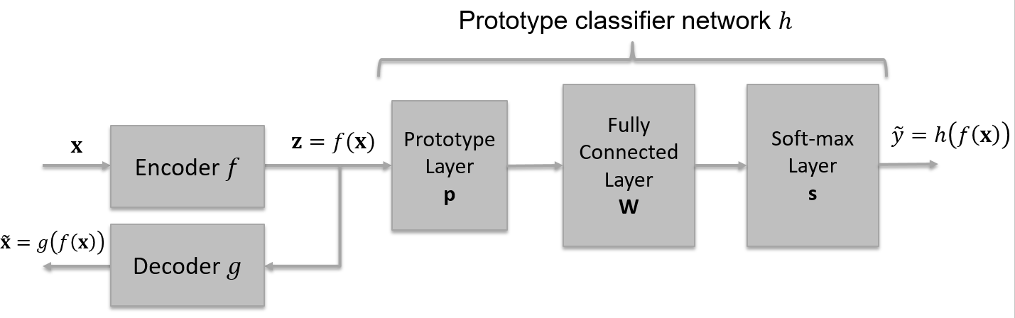
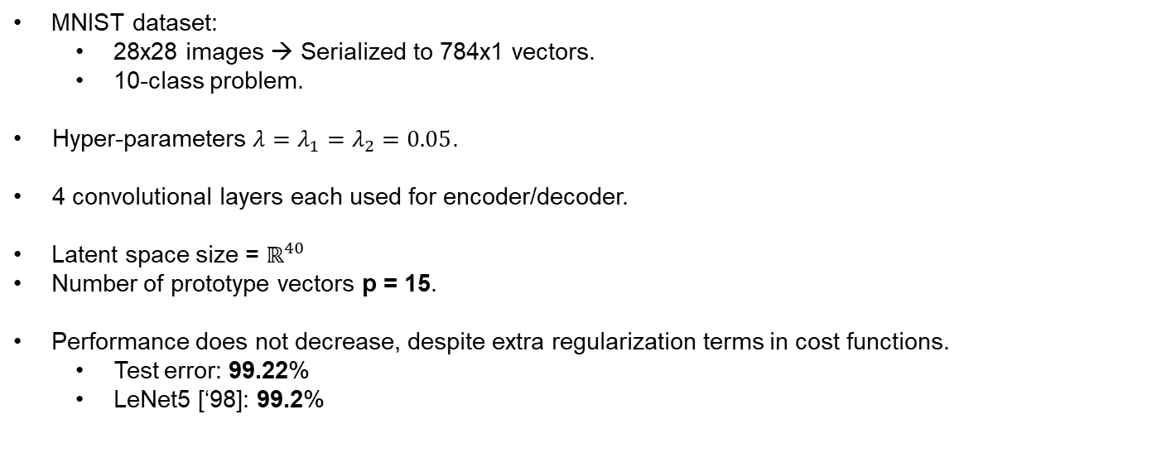
Experimental results
MNIST dataset:
28x28 images → Serialized to 784x1 vectors.
10-class problem.
Hyper-parameters $λ=λ_{1}=λ_{2}=0.05$.
4 convolutional layers each used for encoder/decoder.
Latent space size = $ℝ^{40}$
Number of prototype vectors p = 15.
Performance does not decrease, despite extra regularization terms in cost functions.
Test error: 99.22%
LeNet5 [‘98]: 99.2%

Slide 16
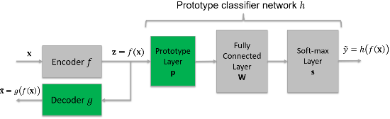
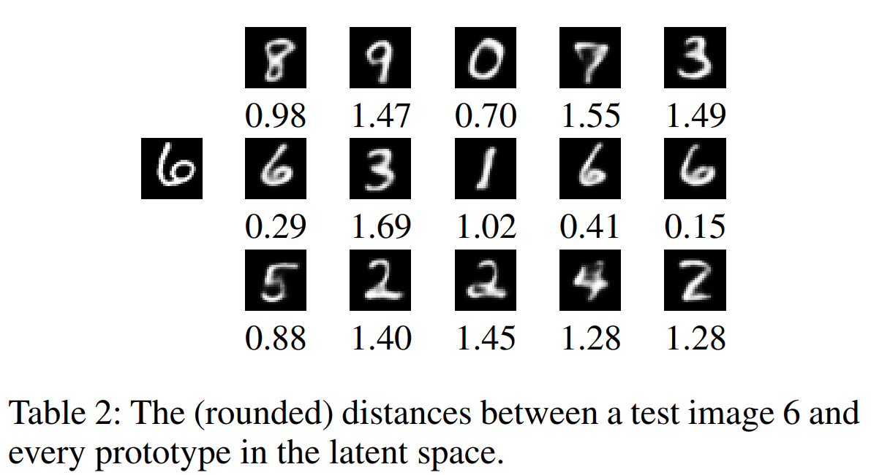
Experimental results
Prototype images are learned, not human designed, but are clearly interpretable.
More prototypes for harder to distinguish digits (e.g. 6 vs. 8, 2 vs. 7)

Slide 17
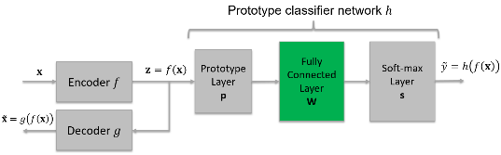
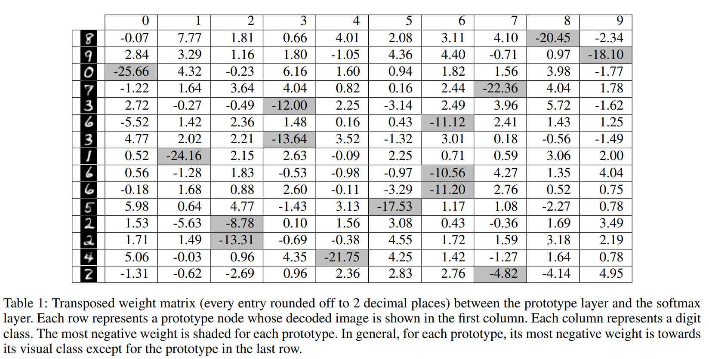
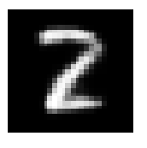
Experimental results
Weight matrix W shows how prototypes are combined to make the final decision.
Most prototypes dominate the decision of a digit and vice versa…
… except
Is this a 2, 7 or 8?

Slide 18
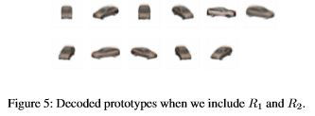
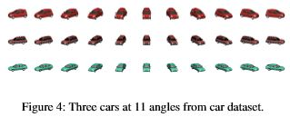
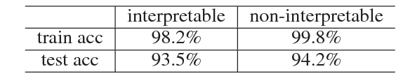
Experimental results
Cars dataset
64 x 64 x 3 pixels of 3D car models with varying azimuth angles at 15 degree intervals (-75 to 75)
11 Classes: views/angles
Training set: 1,859 images
Test set: 154 images

Slide 19
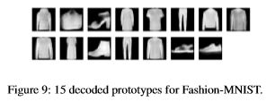
Experimental results
Fashion MNIST dataset
28 x 28 grayscale image
10 Classes: type of clothes item
Training set: 60,000 images
Test set: 10,000 images
Test accuracy of 89.95% which is comparable to methods that used CNN (87.6-92.5%)

Slide 20
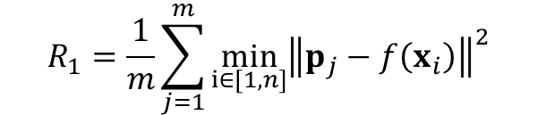
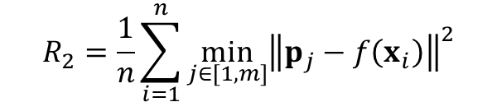
Complexity issues and solutions
$$R_{1}=\frac{1}{m}\sum_{j=1}^{m}{\min_{i∈[1, n]}{{\left\|p_{j}−f\left(x_{i}\right)\right\|}^{2}}}$$
$$R_{2}=\frac{1}{n}\sum_{i=1}^{n}{\min_{j∈[1,m]}{{\left\|p_{j}−f\left(x_{i}\right)\right\|}^{2}}}$$
min taken across all training samples for each p
min taken across all p for each training sample
Solution: Compute R₁ and R₂ on a mini-batch of samples at a time. This is standard anyways for training NNs.
Still, having min terms in the loss functions is not that desirable:
No closed form sub-gradient available.
No re-use between training epochs.

Slide 21
Summary
The authors present an AE-based classifier, with a novel prototype layer added.
Dual purpose of prototype vectors:
Interpretable → Enforced in the latent space.
Good for classification → Clustering-like functionality.
Regularization terms used to enforce these properties.
Some issues with complexity.
No performance loss claimed.

Slide 22
Thank you!

